Slide 1

Object-Oriented Programming
Collection of Data

Slide 2
Acknowledgement
The contents of these slides have origin from School of Computing, National University of Singapore.
We greatly appreciate support from Mr. Aaron Tan Tuck Choy, and Dr. Low Kok Lim for kindly sharing these materials.

Slide 3
Policies for students
These contents are only used for students PERSONALLY.
Students are NOT allowed to modify or deliver these contents to anywhere or anyone for any purpose.

Slide 4
Objectives
Using arrays
Generics: Allowing operations not tired to a specific data type
Classes: Vector and ArrayList

Slide 5
References
Book
Array: Chapter 1, Section 1.1, pages 35 to 38
Generics: Chapter 9, Section 9.4, pages 499 to 507
[503005 Lecture 10: Collection of Data]

Slide 6
Outline (1/2)
0. Recapitulation
Array
1.1 Introduction
1.2 Array in C
1.3 Array in Java
1.4 Array as a Parameter
1.5 Detour: String[] in main() method
1.6 Returning an Array
1.7 Common Mistakes
1.8 2D Array
1.9 Drawback
Generics
2.1 Motivation
2.2 Example: The IntPair Class (non-generic)
2.3 The Generic Pair Class
2.4 Autoboxing/unboxing
2.5 The Generic NewPair Class
2.6 Using the Generic NewPair Class
2.7 Summary
[503005 Lecture 10: Collection of Data]

Slide 7
Outline (2/2)
Vector
3.1 Motivation
3.2 API Documentation
3.3 Example
ArrayList
4.1 Introduction
4.2 API Documentation
4.3 Example
[503005 Lecture 10: Collection of Data]

Slide 8
0. Recapitulation
We explored OOP concepts learned in week 2 in more details (constructors, overloading methods, class and instance methods).
In week 3, we learned some new OOP concepts (encapsulation, accessors, mutators, “this” reference, overriding methods)
UML was introduced to represent OO components
[503005 Lecture 10: Collection of Data]

Slide 9
1 Array
A collection of homogeneous data

Slide 10
Introduction
1. Array
Array is the simplest way to store a collection of data of the same type (homogeneous)
It stores its elements in contiguous memory
Array index begins from zero
Example of a 5-element integer array A with elements filled
A
24
7
-3
15
9
A[0]
A[1]
A[2]
A[3]
A[4]
[503005 Lecture 10: Collection of Data]
Notes:
Homogeneous: đồng nhất
contiguous : kề nhau

Slide 11
Array in C (1/2)
1. Array
#include <stdio.h>
#define MAX 6
int scanArray(double [], int);
void printArray(double [], int);
double sumArray(double [], int);
int main(void) {
double list[MAX];
int size;
size = scanArray(list, MAX);
printArray(list, size);
printf("Sum = %f\n",
sumArray(list, size));
return 0;
}
// To read values into arr and return
// the number of elements read.
int scanArray(double arr[], int max_size) {
int size, i;
printf("How many elements? ");
scanf("%d", &size);
if (size > max_size) {
printf("Exceeded max; you may only enter");
printf(" %d values.\n", max_size);
size = max_size;
}
printf("Enter %d values: ", size);
for (i=0; i<size; i++) {
scanf("%lf", &arr[i]);
}
return size;
}
sum_array.c
[503005 Lecture 10: Collection of Data]

Slide 12
Array in C (2/2)
1. Array
sum_array.c
// To print values of arr
void printArray(double arr[], int size) {
int i;
for (i=0; i<size; i++)
printf("%f ", arr[i]);
printf("\n");
}
// To compute sum of all elements in arr
double sumArray(double arr[], int size) {
int i;
double sum = 0.0;
for (i=0; i<size; i++)
sum += arr[i];
return sum;
}
[503005 Lecture 10: Collection of Data]

Slide 13
Array in Java (1/2)
1. Array
In Java, array is an object.
Every array has a public length attribute (it is not a method!)
TestArray1.java
public class TestArray1 {
public static void main(String[] args) {
int[] arr; // arr is a reference
// create a new integer array with 3 elements
// arr now refers (points) to this new array
arr = new int[3];
// using the length attribute
System.out.println("Length = " + arr.length);
arr[0] = 100;
arr[1] = arr[0] - 37;
arr[2] = arr[1] / 2;
for (int i=0; i<arr.length; i++)
System.out.println("arr[" + i + "] = " + arr[i]);
}
}
Declaring an array:
datatype[] array_name
Constructing an array:
array_name = new datatype[size]
Length = ?
arr[0] = ?
arr[1] = ?
arr[2] = ?
Accessing individual array elements.

[503005 Lecture 10: Collection of Data]

Slide 14
Array in Java (2/2)
1. Array
Alternative loop syntax for accessing array elements
Illustrate toString() method in Arrays class to print an array
TestArray2.java
public class TestArray2 {
public static void main(String[] args) {
// Construct and initialise array
double[] arr = { 35.1, 21, 57.7, 18.3 };
// using the length attribute
System.out.println("Length = " + arr.length);
for (int i=0; i<arr.length; i++) {
System.out.print(arr[i] + " ");
}
System.out.println();
// Alternative way
for (double element: arr) {
System.out.print(element + " ");
}
System.out.println();
System.out.println(Arrays.toString(arr));
}
}
Length = 4
35.1 21.0 57.7 18.3
35.1 21.0 57.7 18.3
[35.1, 21.0, 57.7, 18.3]
Syntax (enhanced for-loop):
for (datatype e: array_name)
Go through all elements in the array. “e” automatically refers to the array element sequentially in each iteration
Using toString() method in Arrays class
[503005 Lecture 10: Collection of Data]

Slide 15
Array as a Parameter
1. Array
The reference to the array is passed into a method
Any modification of the elements in the method will affect the actual array
TestArray3.java
public class TestArray3 {
public static void main(String[] args) {
int[] list = { 22, 55, 33 };
swap(list, 0, 2);
for (int element: list)
System.out.print(element + " ");
System.out.println();
}
// To swap arr[i] with arr[j]
public static void swap(int[] arr, int i, int j) {
int temp = arr[i]; arr[i] = arr[j]; arr[j] = temp;
}
}

[503005 Lecture 10: Collection of Data]

Slide 16
Detour: String[] in main() method
1. Array
The main() method contains a parameter which is an array of String objects
We can use this for command-line arguments
TestCommandLineArgs.java
public class TestCommandLineArgs {
public static void main(String[] args) {
for (int i=0; i<args.length; i++)
System.out.println("args[" + i + "] = " + args[i]);
}
}
java TestCommandLineArgs The "Harry Potter" series has 7 books.
args[0] = The
args[1] = Harry Potter
args[2] = series
args[3] = has
args[4] = 7
args[5] = books.
[503005 Lecture 10: Collection of Data]
Notes:
Detour: đi vòng

Slide 17
Returning an Array
1. Array
Array can be returned from a method
TestArray4.java
public class TestArray4 {
public static void main(String[] args) {
double[] values;
values = makeArray(5, 999.0);
for (double value: values) {
System.out.println(value + " ");
}
}
// To create an array and return it to caller
public static double[] makeArray(int size, double limit) {
double[] arr = new double[size];
for (int i=0; i < arr.length; i++)
arr[i] = limit/(i+1);
return arr;
}
}
999.0
499.5
333.0
249.75
199.8
Return type:
datatype[]
[503005 Lecture 10: Collection of Data]

Slide 18

Common Mistakes (1/3)
1. Array
length versus length()
To obtain length of a String object str, we use the length() method
Example: str.length()
To obtain length (size) of an array arr, we use the length attribute
Example: arr.length
Array index out of range
Beware of ArrayIndexOutOfBoundsException
public static void main(String[] args) {
int[] numbers = new int[10];
. . .
for (int i = 1; i <= numbers.length; i++)
System.out.println(numbers[i]);
}
[503005 Lecture 10: Collection of Data]

Slide 19
Common Mistakes (2/3)
1. Array
When you have an array of objects, it’s very common to forget to instantiate the array’s objects.
Programmers often instantiate the array itself and then think they’re done – that leads to java.lang.NullPointerException
Example on next slide
It uses the Point class in the API
Refer to the API documentation for details
[503005 Lecture 10: Collection of Data]

Slide 20
Common Mistakes (3/3)
1. Array
Point[] array = new Point[3];
for (int i=0; i<array.length; i++) {
array[i].setLocation(1,2);
}
array
null
null
There are no objects referred to by array[0], array[1], and array[2], so how to call setLocation() on them?!
null
x
0
1
Corrected code:
array
y
0
2
Point[] array = new Point[3];
for (int i=0; i<array.length; i++) {
array[i] = new Point();
array[i].setLocation(1,2);
}
x
0
1
y
0
2
x
0
1
y
0
2
[503005 Lecture 10: Collection of Data]

Slide 21
2D Array (1/2)
1. Array
A two-dimensional (2D) array is an array of array.
This allows for rows of different lengths.
// an array of 12 arrays of int
int[][] products = new int[12][];
int[][] array2D = { {4,5,2}, {1,3},
{7,1,5,6} };
4
array2D
5
2
1
3
7
1
5
6
[503005 Lecture 10: Collection of Data]

Slide 22
2D Array (2/2)
array2D
4
1. Array
5
2
1
7
3
1
public class Test2DArray {
public static void main(String[] args) {
int[][] array2D = { {4, 5, 2}, {1, 3}, {7, 1, 5, 6} };
System.out.println("array2D.length = " + array2D.length);
for (int i = 0; i < array2D.length; i++)
System.out.println("array2D[" + i + "].length = "
+ array2D[i].length);
for (int row = 0; row < array2D.length; row++) {
for (int col = 0; col < array2D[row].length; col++)
System.out.print(array2D[row][col] + " ");
System.out.println();
}
}
}
5
6
array2D.length = 3
array2D[0].length = ?
array2D[1].length = ?
array2D[2].length = ?
?
?
?
Test2DArray.java

[503005 Lecture 10: Collection of Data]

Slide 23
Drawback
1. Array
Array has one major drawback:
Once initialized, the array size is fixed
Reconstruction is required if the array size changes
To overcome such limitation, we can use some classes related to array
Java has an Array class
Check API documentation and explore it yourself
However, we will not be using this Array class much; we will be using some other classes such as Vector or ArrayList
Differences between Vector and ArrayList are in slide 41
Before doing Vector/ArrayList, we will introduce another concept called Generics
[503005 Lecture 10: Collection of Data]
Notes:
Drawback: trở ngại

Slide 24
2 Generics
Allowing operation on objects of various types
Notes:
Generics: chung

Slide 25
Motivation
2. Generics
There are programming solutions that are applicable to a wide range of different data types
The code is exactly the same other than the data type declarations
In C, there is no easy way to exploit the similarity:
You need a separate implementation for each data type
In Java, you can make use of generic programming:
A mechanism to specify solution without tying it down to a specific data type
[503005 Lecture 10: Collection of Data]

Slide 26
Eg: The IntPair Class (non-generic)
2. Generics
Let’s define a class to:
Store a pair of integers, e.g. (74, -123)
Many usages, can represent 2D coordinates, range (min to max), height and weight, etc.
IntPair.java
class IntPair {
private int first, second;
public IntPair(int a, int b) {
first = a;
second = b;
}
public int getFirst() { return first; }
public int getSecond() { return second; }
}
[503005 Lecture 10: Collection of Data]

Slide 27
Using the IntPair Class (non-generic)
2. Generics
// This program uses the IntPair class to create an object
// containing the lower and upper limits of a range.
// We then use it to check that the input data fall within
// that range.
import java.util.Scanner;
public class TestIntPair {
public static void main(String[] args) {
IntPair range = new IntPair(-5, 20);
Scanner sc = new Scanner(System.in);
int input;
do {
System.out.printf("Enter a number in (%d to %d): ",
range.getFirst(), range.getSecond());
input = sc.nextInt();
} while( input < range.getFirst() ||
input > range.getSecond() );
}
}
Enter a number in (-5 to 20): -10
Enter a number in (-5 to 20): 21
Enter a number in (-5 to 20): 12
TestIntPair.java
[503005 Lecture 10: Collection of Data]

Slide 28
Observation
2. Generics
The IntPair class idea can be easily extended to other data types:
double, String, etc.
The resultant code would be almost the same!
class StringPair {
private String first, second;
public StringPair( String a, String b ) {
first = a;
second = b;
}
public String getFirst() { return first; }
public String getSecond() { return second; }
}
Only differences are the data type declarations
[503005 Lecture 10: Collection of Data]

Slide 29
The Generic Pair Class
2. Generics
class Pair <T> {
private T first, second;
public Pair(T a, T b) {
first = a;
second = b;
}
public T getFirst() { return first; }
public T getSecond() { return second; }
}
Pair.java
Important restriction:
The generic type can be substituted by reference data type only
Hence, primitive data types are NOT allowed
Need to use wrapper class for primitive data type
[503005 Lecture 10: Collection of Data]

Slide 30
Using the Generic Pair Class
2. Generics
TestGenericPair.java
public class TestGenericPair {
public static void main(String[] args) {
Pair<Integer> twoInt = new Pair<Integer>(-5, 20);
Pair<String> twoStr = new Pair<String>("Turing", "Alan");
// You can have pair of any reference data types!
// Print out the integer pair
System.out.println("Integer pair: (" + twoInt.getFirst()
+ ", " + twoInt.getSecond() + ")";
// Print out the String pair
System.out.println("String pair: (" + twoStr.getFirst()
+ ", " + twoStr.getSecond() + ")";
}
}
The formal generic type <T> is substituted with the actual data type supplied by the user:
The effect is similar to generating a new version of the Pair class, where T is substituted
[503005 Lecture 10: Collection of Data]

Slide 31
Autoboxing/unboxing (1/2)
2. Generics
The following statement invokes autoboxing
Pair<Integer> twoInt = new Pair<Integer>(-5, 20);
Integer objects are expected for the constructor, but -5 and 20, of primitive type int, are accepted.
Autoboxing is the automatic conversion that the Java compiler makes between the primitive types and their corresponding object wrapper classes
The primitive values -5 and 20 are converted to objects of Integer
The Java compiler applies autoboxing when a primitive value is:
Passed as a parameter to a method that expects an object of the corresponding wrapper class
Assigned to a variable of the correspond wrapper class
[503005 Lecture 10: Collection of Data]

Slide 32
Autoboxing/unboxing (2/2)
2. Generics
Converting an object of a wrapper type (e.g.: Integer) to its corresponding primitive (e.g: int) value is called unboxing.
The Java compiler applies unboxing when an object of a wrapper class is:
Passed as a parameter to a method that expects a value of the corresponding primitive type
Assigned to a variable of the corresponding primitive type
int i = new Integer(5); // unboxing
Integer intObj = 7; // autoboxing
System.out.println("i = " + i);
System.out.println("intObj = " + intObj);
i = 5
intObj = 7
int a = 10;
Integer b = 10; // autoboxing
System.out.println(a == b);
true
[503005 Lecture 10: Collection of Data]

Slide 33
The Generic NewPair Class
2. Generics
We can have more than one generic type in a generic class
Let’s modify the generic pair class such that:
Each pair can have two values of different data types
class NewPair <S,T> {
private S first;
private T second;
public NewPair(S a, T b) {
first = a;
second = b;
}
public S getFirst() { return first; }
public T getSecond() { return second; }
}
You can have multiple generic data types.
Convention: Use single uppercase letters for generic data types.
NewPair.java
[503005 Lecture 10: Collection of Data]

Slide 34
Using the Generic NewPair Class
TestNewGenericPair.java
2. Generics
public class TestNewGenericPair {
public static void main(String[] args) {
NewPair<String, Integer> someone =
new NewPair<String, Integer>("James Gosling", 55);
System.out.println("Name: " + someone.getFirst());
System.out.println("Age: " + someone.getSecond());
}
}
Name: James Gosling
Age: 55
This NewPair class is now very flexible!
Can be used in many ways
[503005 Lecture 10: Collection of Data]

Slide 35
Summary
2. Generics
Caution:
Generics are useful when the code remains unchanged other than differences in data types
When you declare a generic class/method, make sure that the code is valid for all possible data types
Additional Java Generics topics (not covered):
Generic methods
Bounded generic data types
Wildcard generic data types
[503005 Lecture 10: Collection of Data]

Slide 36
3 Vector class
Class for dynamic-size arrays

Slide 37
Motivation
3. Vector
Java offers a Vector class to provide:
Dynamic size
expands or shrinks automatically
Generic
allows any reference data types
Useful predefined methods
Use array if the size is fixed; use Vector if the size may change.
[503005 Lecture 10: Collection of Data]

Slide 38
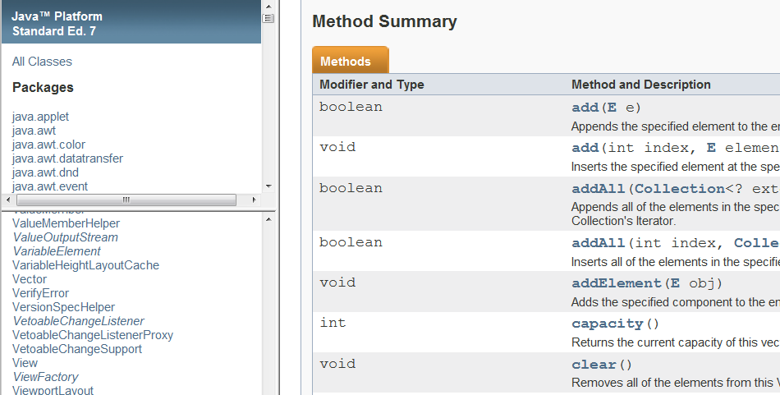
API documentation (1/3)
3. Vector
[503005 Lecture 10: Collection of Data]

Slide 39
API documentation (2/3)
3. Vector
PACKAGE
import java.util.Vector;
SYNTAX
//Declaration of a Vector reference
Vector<E> myVector;
//Initialize a empty Vector object
myVector = new Vector<E>;
Commonly Used Method Summary
boolean | isEmpty() Tests if this vector has no components.
int | size() Returns the number of components in this vector.
[503005 Lecture 10: Collection of Data]

Slide 40
API documentation (3/3)
3. Vector
Commonly Used Method Summary (continued)
boolean | add(E o) Appends the specified element to the end of this Vector.
void | add(int index, E element) Inserts the specified element at the specified position in this Vector.
E | remove(int index) Removes the element at the specified position in this Vector.
boolean | remove(Object o) Removes the first occurrence of the specified element in this Vector If the Vector does not contain the element, it is unchanged.
E | get(int index) Returns the element at the specified position in this Vector.
int | indexOf(Object elem) Searches for the first occurrence of the given argument, testing for equality using the equals method.
boolean | contains(Object elem) Tests if the specified object is a component in this vector.
[503005 Lecture 10: Collection of Data]

Slide 41
Example
3. Vector
TestVector.java
import java.util.Vector;
public class TestVector {
public static void main(String[] args) {
Vector<String> courses;
courses = new Vector<String>();
courses.add("503005");
courses.add(0, "501042");
courses.add("502043");
System.out.println(courses);
System.out.println("At index 0: " + courses.get(0));
if (courses.contains("503005"))
System.out.println("503005 is in courses");
courses.remove("503005");
for (String c: courses)
System.out.println(c);
}
}
Output:
[501042, 503005, 502043]
At index 0: 501042
503005 is in courses
501042
502043
Vector class has a nice toString() method that prints all elements
The enhanced for-loop is applicable to Vector objects too!
[503005 Lecture 10: Collection of Data]

Slide 42
4 ArrayList class
Another class for dynamic-size arrays

Slide 43
Introduction (1/2)
Java offers an ArrayList class to provide similar features as Vector:
Dynamic size
expands or shrinks automatically
Generic
allows any reference data types
Useful predefined methods
Similarities:
Both are index-based and use an array internally
Both maintain insertion order of element
So, what are the differences between Vector and ArrayList?
This is one of the most frequently asked questions, and at interviews!
4. ArrayList
[503005 Lecture 10: Collection of Data]

Slide 44
Introduction (2/2)
Differences between Vector and ArrayList
4. ArrayList
Vector | ArrayList
Since JDK 1.0 | Since JDK 1.2
Synchronised * (thread-safe) | Not synchronised
Slower (price of synchronisation) | Faster (≈20 – 30%)
Expansion: default to double the size of its array (can be set) | Expansion: increases its size by ≈50%
ArrayList is preferred if you do not need synchronisation
Java supports multiple threads, and these threads may read from/write to the same variables, objects and resources. Synchronisation is a mechanism to ensure that Java thread can execute an object’s synchronised methods one at a time.
When using Vector /ArrayList, always try to initialise to the largest capacity that your program will need, since expanding the array is costly.
Array expansion: allocate a larger array and copy contents of old array to the new one
[503005 Lecture 10: Collection of Data]

Slide 45
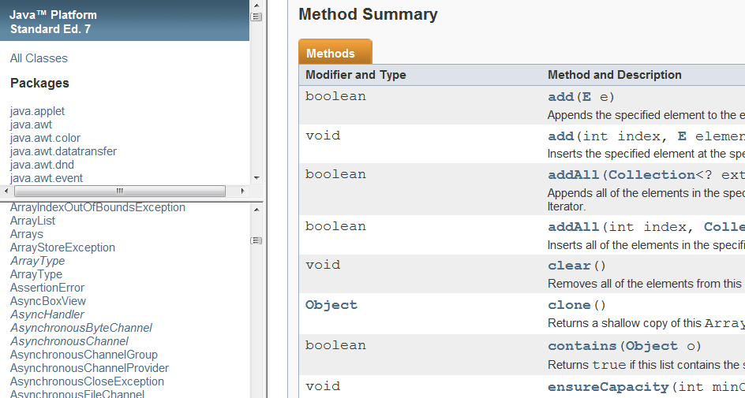
API documentation (1/3)
4. ArrayList
[503005 Lecture 10: Collection of Data]

Slide 46
API documentation (2/3)
PACKAGE
import java.util.ArrayList;
4. ArrayList
SYNTAX
//Declaration of a ArrayList reference
ArrayList<E> myArrayList;
//Initialize a empty ArrayList object
myArrayList = new ArrayList<E>;
Commonly Used Method Summary
boolean | isEmpty() Returns true if this list contains no element.
int | size() Returns the number of elements in this list.
[503005 Lecture 10: Collection of Data]

Slide 47
API documentation (3/3)
Commonly Used Method Summary (continued)
boolean | add(E e) Appends the specified element to the end of this list.
void | add(int index, E element) Inserts the specified element at the specified position in this list.
E | remove(int index) Removes the element at the specified position in this list.
boolean | remove(Object o) Removes the first occurrence of the specified element from this list, if it is present.
E | get(int index) Returns the element at the specified position in this list.
int | indexOf(Object o) Returns the index of the first occurrence of the specified element in this list, or -1 if this list does not contain the element.
boolean | contains(Object elem) Returns true if this list contains the specified element.
4. ArrayList
[503005 Lecture 10: Collection of Data]

Slide 48
Example
TestArrayList.java
import java.util.ArrayList;
import java.util.Scanner;
public class TestArrayList {
public static void main(String[] args) {
Scanner sc = new Scanner(System.in);
ArrayList<Integer> list = new ArrayList<Integer>();
System.out.println("Enter a list of integers, press ctrl-d to end.");
while (sc.hasNext()) {
list.add(sc.nextInt());
}
System.out.println(list); // using ArrayList's toString()
// Move first value to last
list.add(list.remove(0));
System.out.println(list);
}
}
4. ArrayList
Output:
Enter a list ... to end.
31
17
-5
26
50
(user pressed ctrl-d here)
[31, 17, -5, 26, 50]
[17, -5, 26, 50, 31]
[503005 Lecture 10: Collection of Data]

Slide 49
Summary
Java Elements
Array:
- Declaration and common usage
Generics:
- Allowing operation on objects of various types
Vector and ArrayList:
- Dynamic-size arrays
- Declaration and useful methods
[503005 Lecture 10: Collection of Data]

Slide 50
Practice Exercises
#12: Basic Statistics
Computing mean and standard deviation
#13: Missing Digits
Using array of primitive type
#14: Missing Digits version 2
Using Vector
#15: Row and Column Sums
Two-dimensional array
#16: Set Containment
Using ArrayList and writing your own class
#17: Nearest Points
Using ArrayList and Point
[503005 Lecture 10: Collection of Data]

Slide 51
Missing Digits (1/2)
[This is adapted from a 501042 exercise in C] Write a program MissingDigits.java to read in a positive integer and list out all the digits that do not appear in the input number. (Assume input value has no leading zeroes.)
You are to use primitive array, not Vector, ArrayList or any other related classes.
You should use a boolean array.
Sample run:
Pract. Ex. #13
Enter a number: 73015
Missing digits in 73015: 2 4 6 8 9
[503005 Lecture 10: Collection of Data]

Slide 52

Missing Digits (2/2)
What is the boolean array for? Idea?
Pract. Ex. #13
[503005 Lecture 10: Collection of Data]

Slide 53
Detecting Duplicates (1/4)
Using ArrayList class and random number generation.
You may use the Math random() method or the Random class
Write a program DetectDuplicates.java to read the following values:
The number of unique random integers to generate; and
Limit of the values: each random number generated should be in the range from 0 (inclusive) to limit (exclusive), or [0, limit – 1].
(Certainly, the second input value must not be smaller than the first)
Each time a random integer is generated, you must check if it is a duplicate of an earlier generated value. If it is, it must be discarded. The program goes on to generate the required number of unique random integers.
You are to count how many duplicates were detected.
Additional Exercise
[503005 Lecture 10: Collection of Data]

Slide 54
Detecting Duplicates (2/4)
Sample run
(In testing your code, each time a random number is generated, you may want to print it to check that the computation is correct)
Additional Exercise
Enter number of unique integers to generate: 10
Enter limit: 20
List: [16, 3, 15, 17, 2, 10, 18, 5, 12, 14]
Duplicates detected: 8
[503005 Lecture 10: Collection of Data]

Slide 55
Detecting Duplicates (3/4)
DetectDuplicates.java
import java.util.*;
public class DetectDuplicates {
public static void main(String[] args) {
Scanner sc = new Scanner(System.in);
ArrayList<Integer> list = new ArrayList<Integer>();
System.out.print("Enter number of unique ...: ");
int numUnique = sc.nextInt();
System.out.print("Enter limit: ");
int limit = sc.nextInt();
Random rnd = new Random();
int countUnique = 0;
int countDuplicates = 0;
int num; // the random number
Additional Exercise
[503005 Lecture 10: Collection of Data]

Slide 56
Detecting Duplicates (4/4)
DetectDuplicates.java
System.out.println("List: " + list);
System.out.println("Duplicates detected: "
+ countDuplicates);
}
}
Additional Exercise
[503005 Lecture 10: Collection of Data]

Slide 57
End of file

